Slide 1


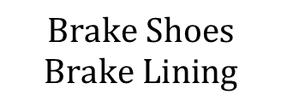




Brake System
$$ω_{wheel}$$
$$Actuator$$
$$Brake Drum$$
$$F_{cl}$$
$$F_{cl}$$
$$Return Springs$$
$$Brake Shoes$$
$$Brake Lining$$

Slide 2




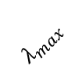




Brake System
$$θ_{2}$$
$$m_{22}$$
$$|M^{−1}|$$
$${\hat{θ}}_{2}$$
$$λ_{max}$$
$$m_{11}$$
$$0$$
$${\hat{θ}}_{1}$$
$$θ_{1}$$

Slide 3









Agent
$$a$$
Parallel Environments
$$\log{π_{θ}}$$
Actor Network
Memory
EMB Environment
$${\left[o, a, r, d,log{π_{θ}}\right]}_{0} \\ ∙∙∙ \\ {\left[o, a, r, d,\log{π_{θ}}\right]}_{n}$$
$$A$$
EMB Environment
EMB Environment
EMB-Environment
Advantage Caculation
$$r$$
$$V$$
$$o_{a}$$
$$o, r, d$$
$$o_{c}$$
Critic Network

Slide 4


Agent
$$a$$
EMB Environment
or EMB in Real World
Actor Network
$$o_{a}$$

Slide 5





$$PDF(θ)$$
$$\frac{1}{{θ_{max}−θ}_{min}}$$
$$0$$
$$θ_{min}$$
$$θ_{max}$$
$$θ$$

Slide 6
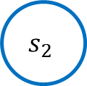
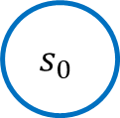
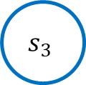

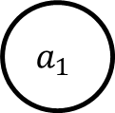
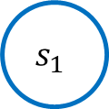

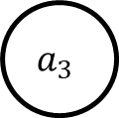



$$s_{0}$$
$$a_{1}$$
$$s_{1}$$
$$a_{2}$$
$$s_{2}$$
$$a_{3}$$
$$s_{3}$$
$$⋯$$
$$r_{1}$$
$$r_{2}$$
$$r_{3}$$

